Slide 1
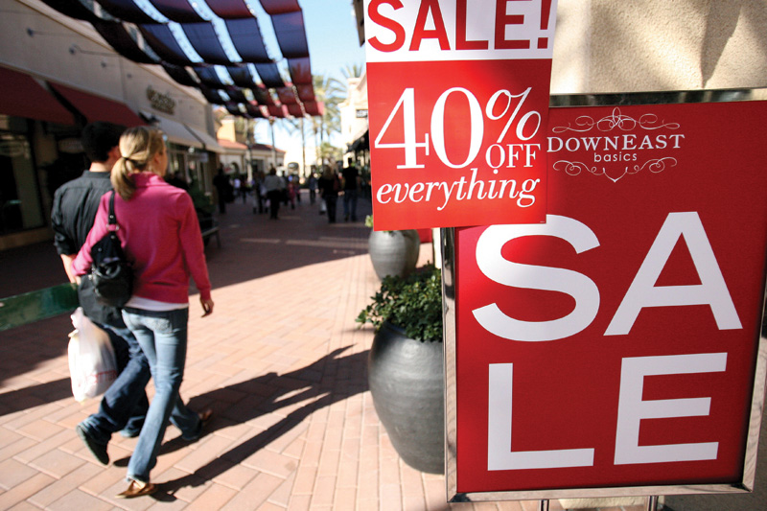
Just How Badly Do You Want It?

Slide 2

PRICE ELASTICITY OF DEMAND
Elasticity measures how responsive quantity demanded is to a change in price.

Slide 3

Elasticity (or price elasticity of demand) measures by how much quantity demanded responds to a change in price
Simple formula is

Slide 4
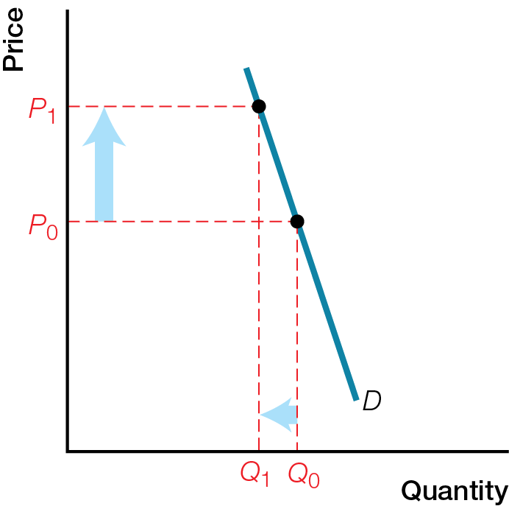
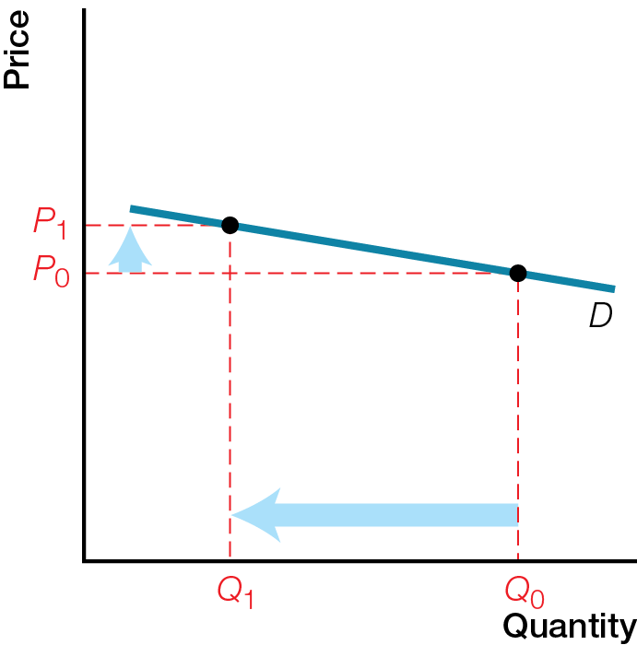
Inelastic Demand vs Elastic Demand
Inelastic Demand for Insulin
b) Elastic Demand for Blue Earbuds

Slide 5
Elasticity (or price elasticity of demand) measures by how much quantity demanded responds to a change in price
Simple formula is

Slide 6
Inelastic demand small response in quantity demanded when price rises
Example: Demand for insulin by a diabetic
Elasticity < 1
Low willingness to shop elsewhere
Elastic demand large response in quantity demanded when price rises
Example: Demand for blue earbuds
Elasticity > 1
High willingness to shop elsewhere

Slide 7
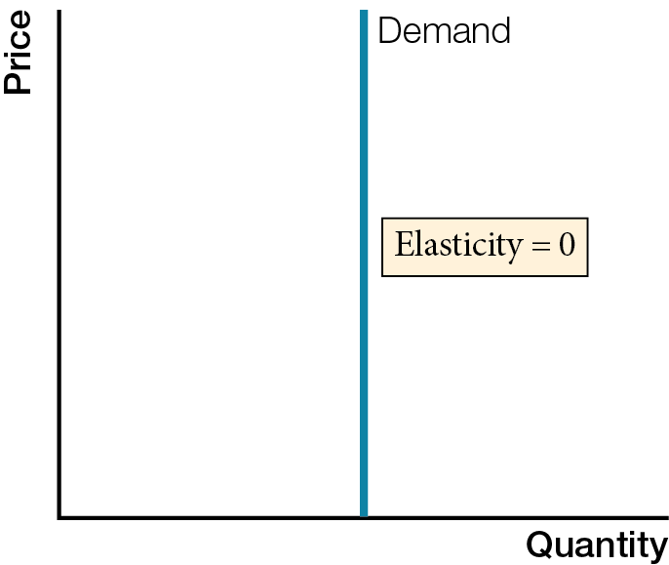
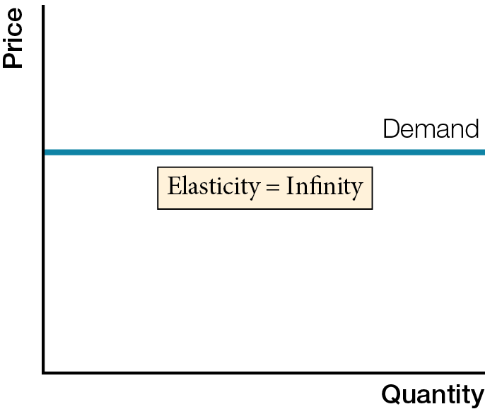
Extreme Elasticities of Demand
Perfectly Inelastic Demand
b) Perfectly Elastic Demand

Slide 8
Perfectly inelastic demand price elasticity of demand equals zero; quantity demanded does not respond to change in price
Vertical demand curve
Perfectly elastic demand price elasticity of demand equals infinity; quantity demanded has infinite response to change in price
Horizontal demand curve

Slide 9
The price elasticity of demand is influenced by
Available substitutes — more substitutes mean more elastic demand
Time to adjust — longer time to adjust means more elastic demand
Proportion of income spent — greater proportion of income spent on a product or service means more elastic demand

Slide 10
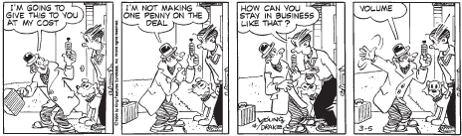
ELASTICITY AND TOTAL REVENUE
Elasticity determines business pricing strategies to earn maximum total revenue – cut prices when demand is elastic and raise prices when demand is inelastic.

Slide 11
Total revenue (all money a business receives from sales) = price per unit (P) multiplied by quantity sold (Q)
For businesses facing elastic demand (> 1), price cuts increase total revenue
For businesses facing inelastic demand (< 1), price rises increase total revenue

Slide 12


Slide 15
As you move down a straight line demand curve, elasticity changes and is not the same as slope
Elasticity goes from elastic, to unit elastic, to inelastic
Total revenue increases, reaches a maximum when elasticity equals 1, then decreases

Slide 16
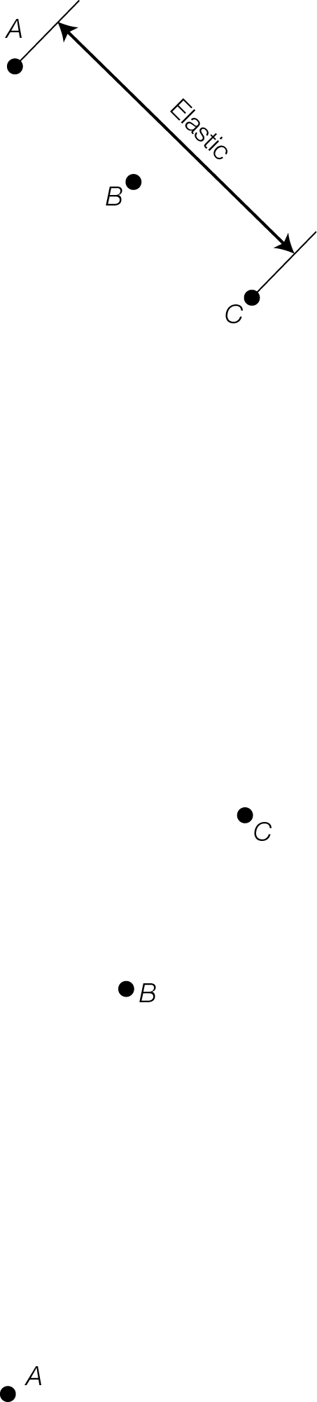
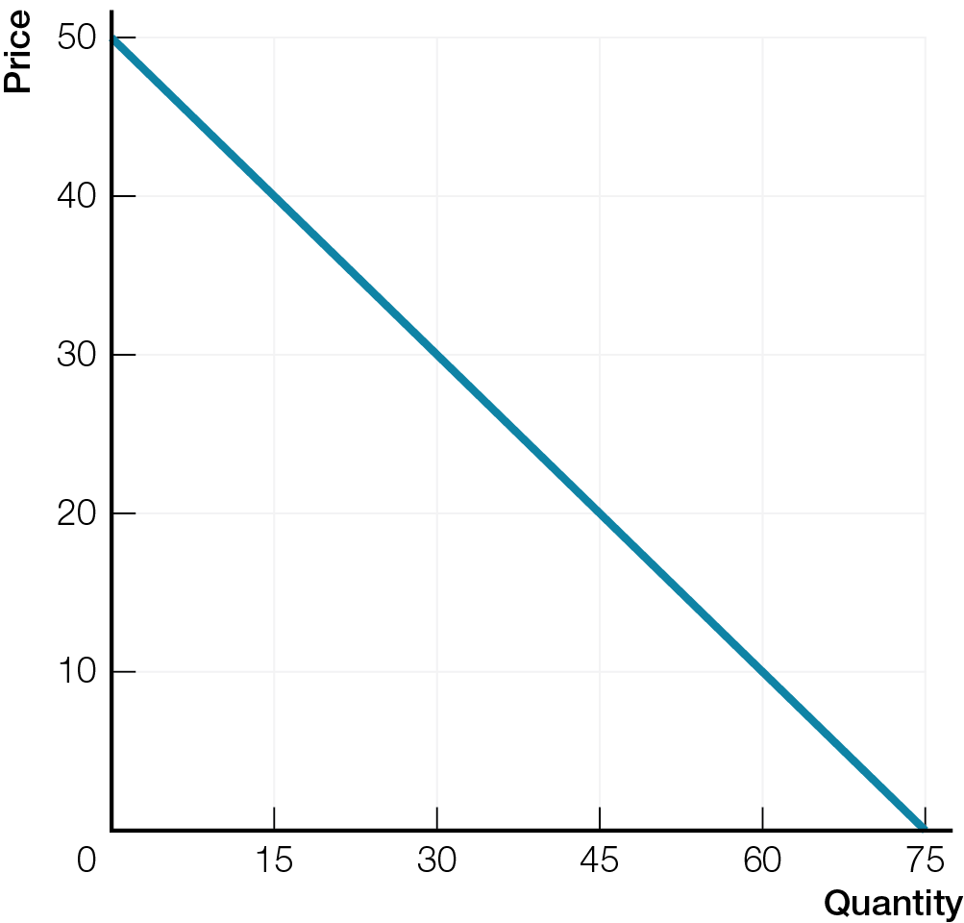
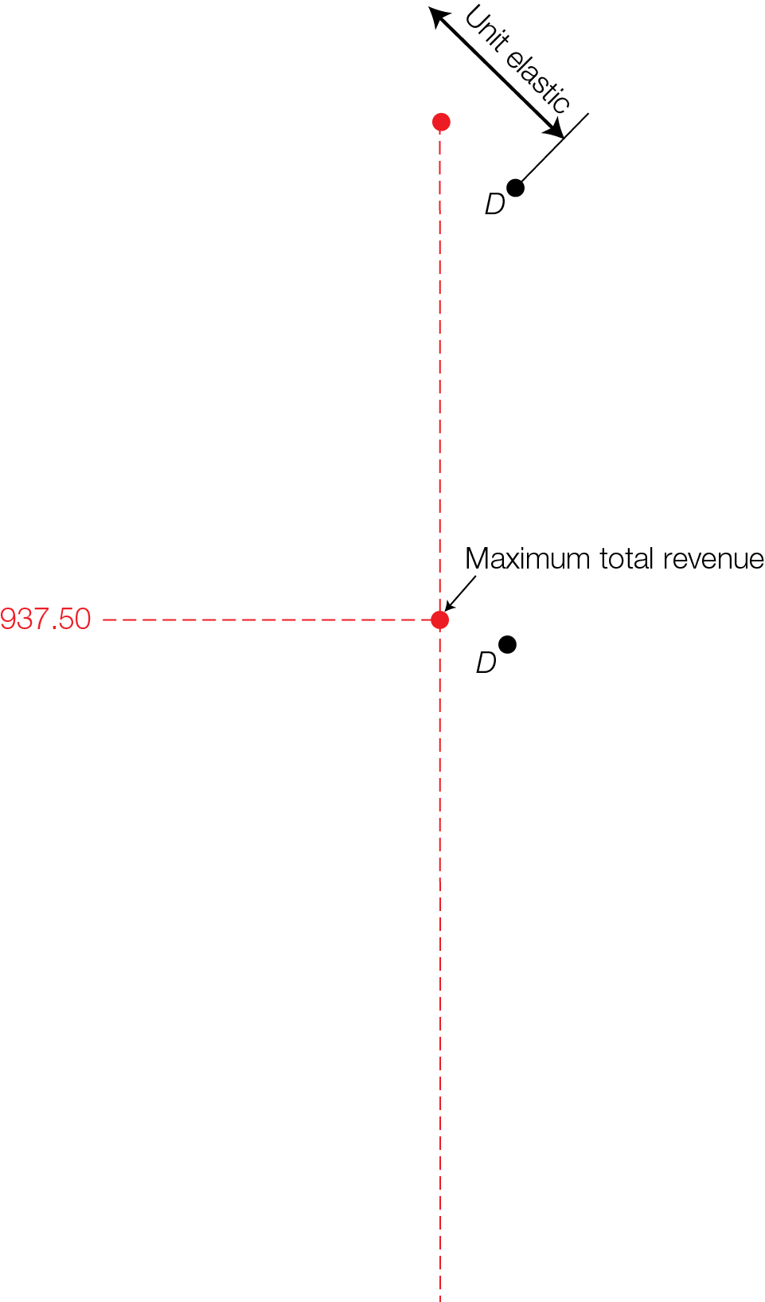
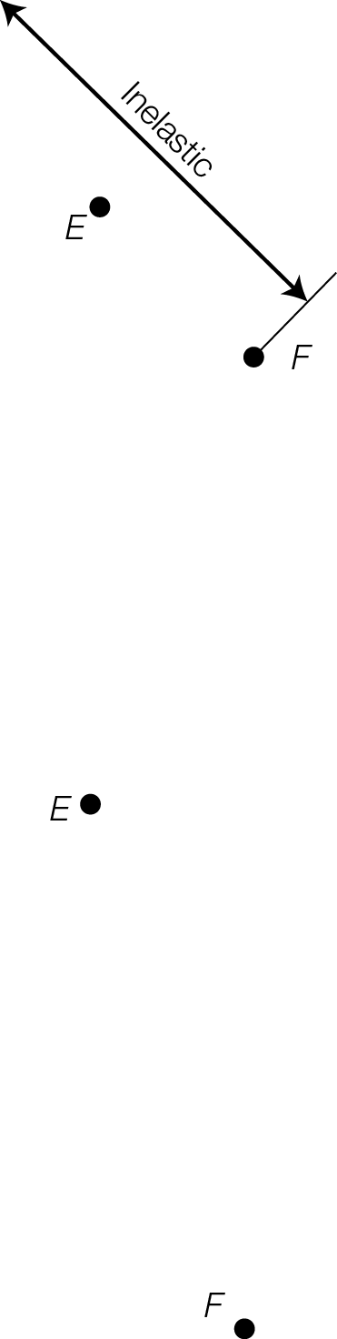
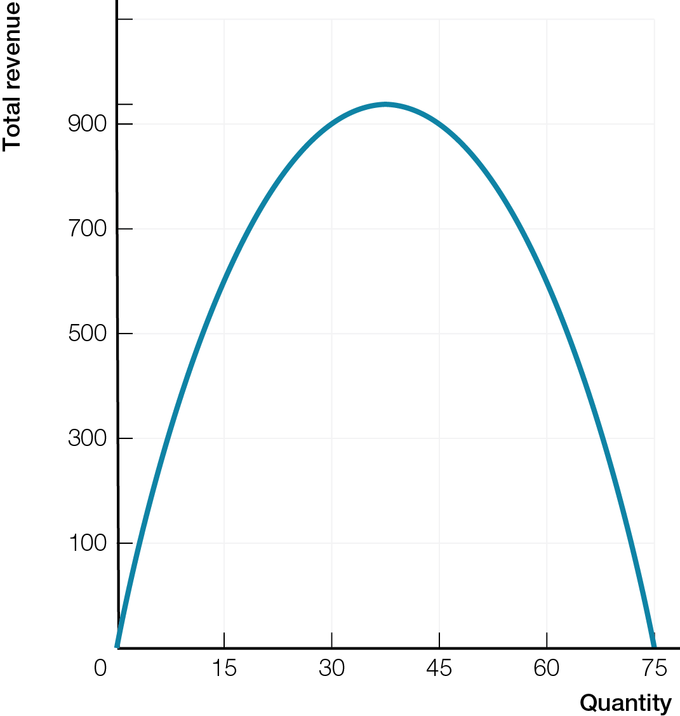
Elasticity and Total Revenue
Fig. 5.5

Slide 17
Concession stands at movie theatres charge high prices for popcorn, drinks, and other refreshments. This pricing strategy increases total revenue. What does that imply about the price elasticity of demand for refreshments in movie theatres? What theatre policy helps make this demand elastic or inelastic?
“Why Do We Eat Popcorn at the Movies?”
http://www.smithsonianmag.com/arts-culture/why-do-we-eat-popcorn-at-the-movies-475063/?no-ist

Slide 18

PRICE ELASTICITY OF SUPPLY
Elasticity of supply measures the responsiveness of quantity supplied to a change in price, and depends on the difficulty, expense, and time involved in increasing production.

Slide 19
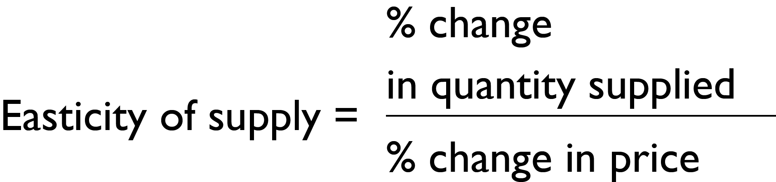
Elasticity of supply measures by how much quantity supplied responds to a change in price
Simple formula is

Slide 20
Inelastic supply small response in quantity supplied when price rises
Difficult and expensive to increase production
Example: supply of mined gold
Elasticity of supply < 1
Elastic supply large response in quantity supplied when price rises
Easy and inexpensive to increase production
Example: snow-shoveling services
Elasticity of supply > 1

Slide 21
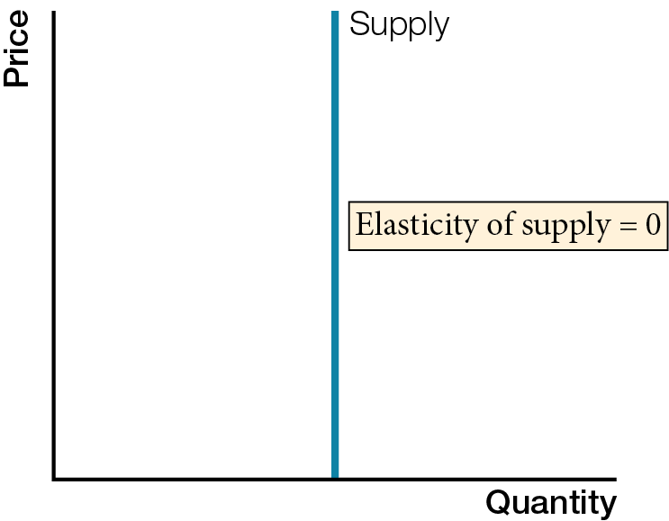
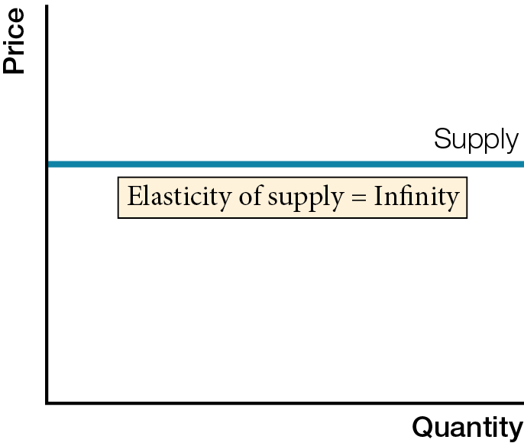
Extreme Elasticities of Supply
Perfectly Inelastic Supply
b) Perfectly Elastic Supply

Slide 22
Perfectly inelastic supply price elasticity of supply = 0; quantity supplied does not respond to change in price
Perfectly elastic supply price elasticity of supply = infinity; quantity supplied has infinite response to change in price

Slide 23
Elasticity of supply influenced by
Availability of additional inputs — more available inputs means more elastic supply
Time production takes — less time means more elastic supply
Elasticity of supply allows more accurate predictions of future outputs and prices, helping businesses avoid disappointing customers

Slide 24
MORE ELASTICITIES OF DEMAND
Elasticity measures explain the responsiveness of quantity demanded to changes in prices of related products and income, and the division of a tax between buyers and sellers.

Slide 25
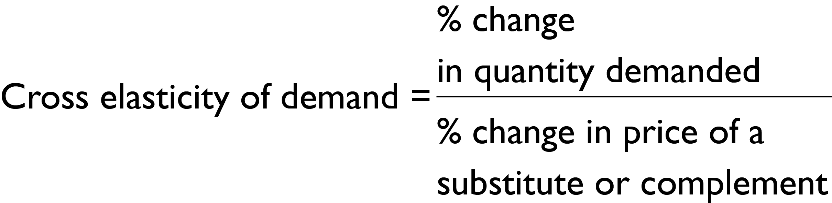
Cross elasticity of demand measures responsiveness of the demand for a product or service to a change in price of a substitute or complement
Simple formula is

Slide 26
Cross elasticity of demand is a positive number for substitutes. The larger the number, the
Larger the change (increase) in demand
Larger the rightward shift of the demand curve
Closer products or services are to perfect substitutes
Cross elasticity of demand is a negative number for complements. The larger the number, the
Larger the change (decrease) in demand
Larger the leftward shift of the demand curve
Closer products or services are to perfect complements

Slide 27

Income elasticity of demand measures responsiveness of the demand for a product or service to a change in income
Simple formula is
Positive for normal goods; increase in income increases demand for normal goods
Negative for inferior goods; increase in income decreases demand for inferior goods

Slide 28
Income inelastic demand
Income elasticity less than 1, but greater than 0
% change in quantity is less than % change in price
Normal goods that are necessities
Income elastic demand
Income elasticity greater than 1
% change in quantity is greater than % change in price
Normal goods that are luxuries

Slide 29

TAX INCIDENCE & GOVERNMENT TAX CHOICES
Who pays a tax depends on elasticities of demand and supply – the more inelastic demand, the more buyers pay, and the more inelastic supply, the more sellers pay.

Slide 30
Tax incidence the division of a tax between buyers and sellers; depends on elasticities of demand and supply
Who pays the GST/HST – businesses or consumers ?

Slide 31
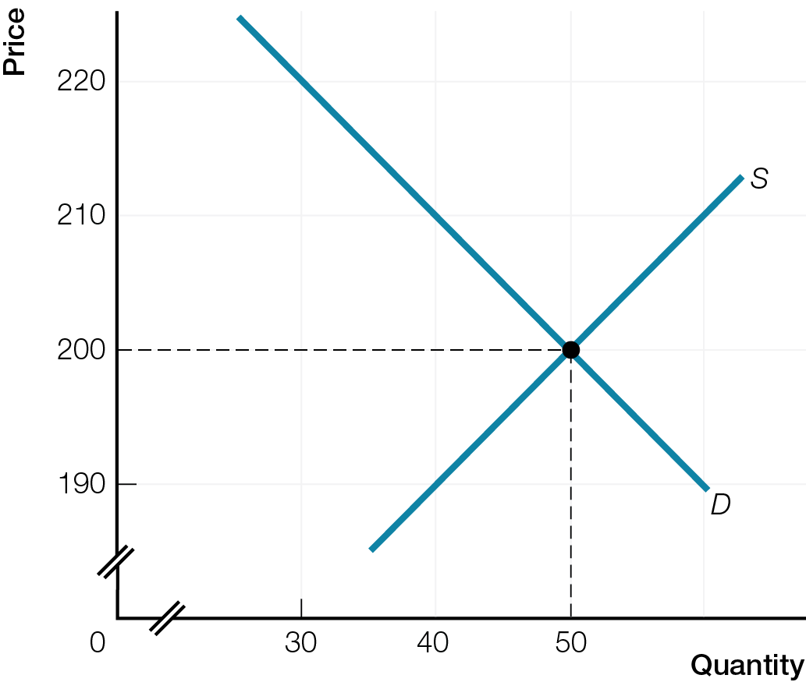
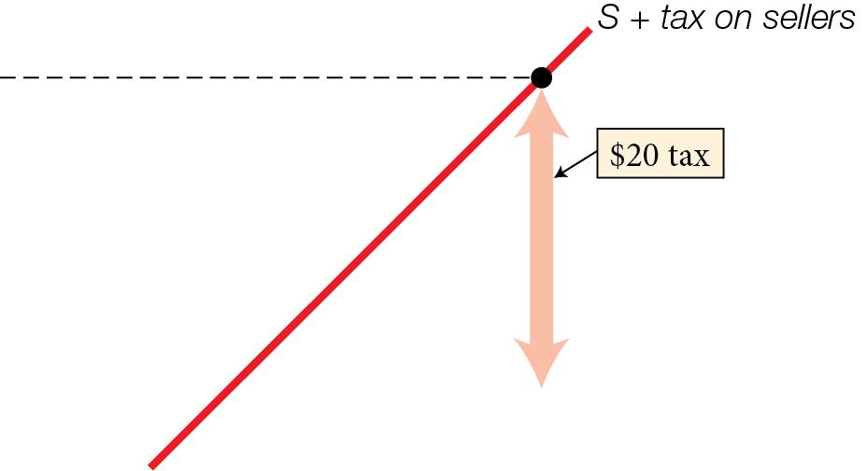
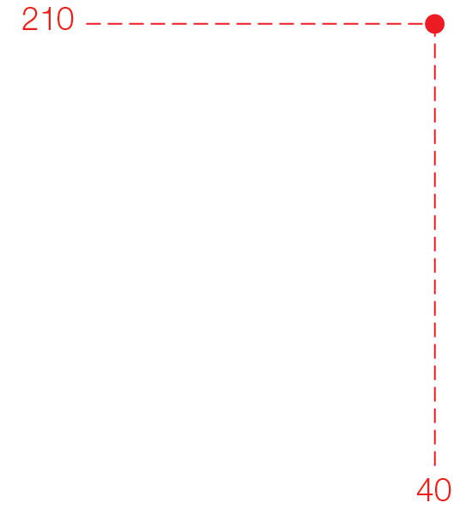
A Sales Tax on Businesses
Fig. 5.8

Slide 32
A Sales Tax on Businesses
Fig. 5.8

Slide 33
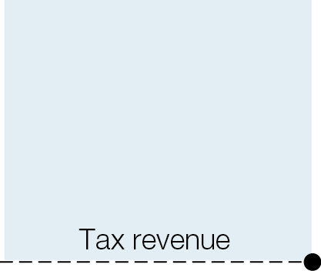
Tax Revenues
Fig. 5.12

Slide 34
The more inelastic demand and supply are, greater the tax revenue for government
For maximum revenue, governments try to tax products and services with inelastic demands and supplies

Slide 35
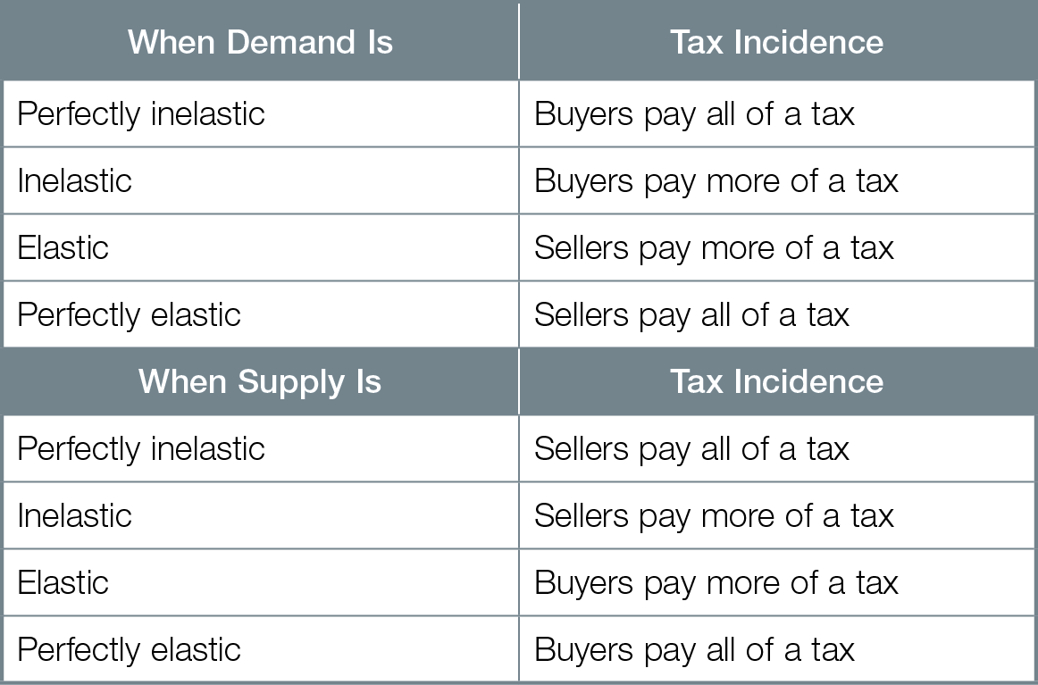
Elasticity and Tax Incidence

